Slide 1
Workshop on How to make and use powerpoint presentation.
13th March 2019
Mr.Arif Khan

Slide 2
1. Introduction to PowerPoint
- Overview of PowerPoint: Purpose, features, and benefits.
- Importance of effective visual communication in presentations.
2. Getting Started with PowerPoint
- Launching PowerPoint: Opening a new presentation.
- Navigating the interface: Ribbon, slides, and views.
- Understanding slide layouts: Choosing the right layout for your content.

Slide 3
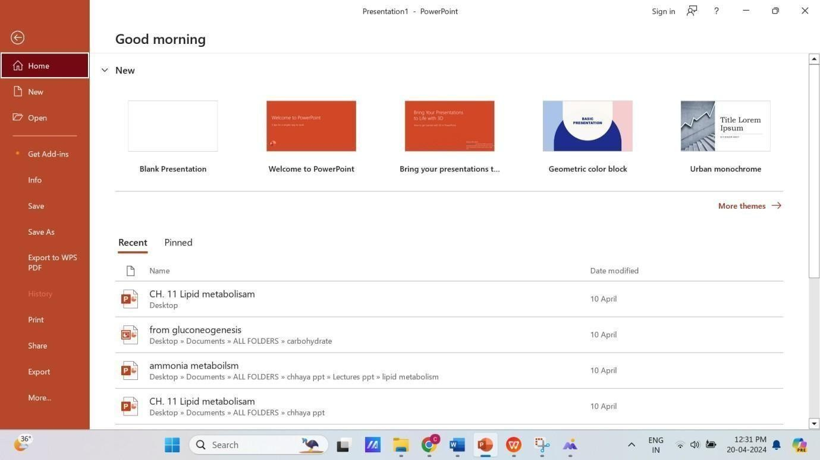

Slide 4
3. Creating and Formatting Slides
- Adding and deleting slides: Basic slide management.
- Inserting text: Formatting text boxes, fonts, and alignment.
- Incorporating visuals: Inserting images, shapes, and icons.
- Applying themes and templates: Customizing the look and feel of your presentation.
4. Enhancing Visual Appeal
- Using colors and fonts effectively: Creating a cohesive design.
- Incorporating multimedia: Adding audio and video files.

Slide 5
Applying animations and transitions: Engaging the audience with dynamic effects.
- Using SmartArt and charts: Visualizing data and concepts.

Slide 6
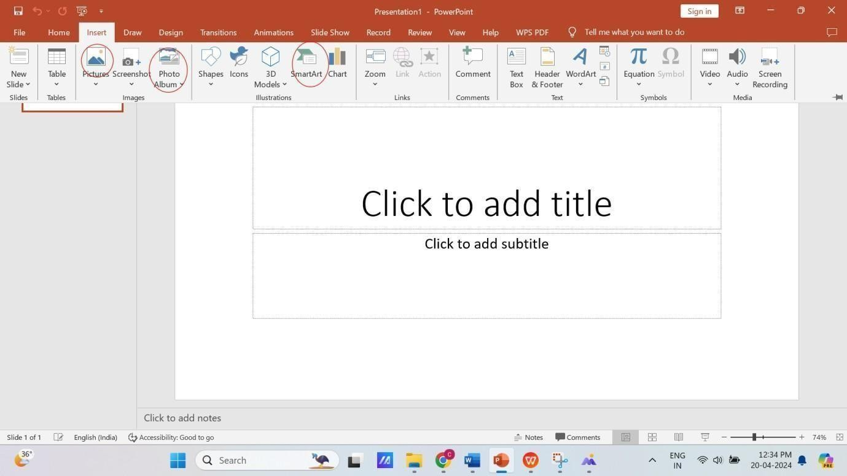

Slide 7
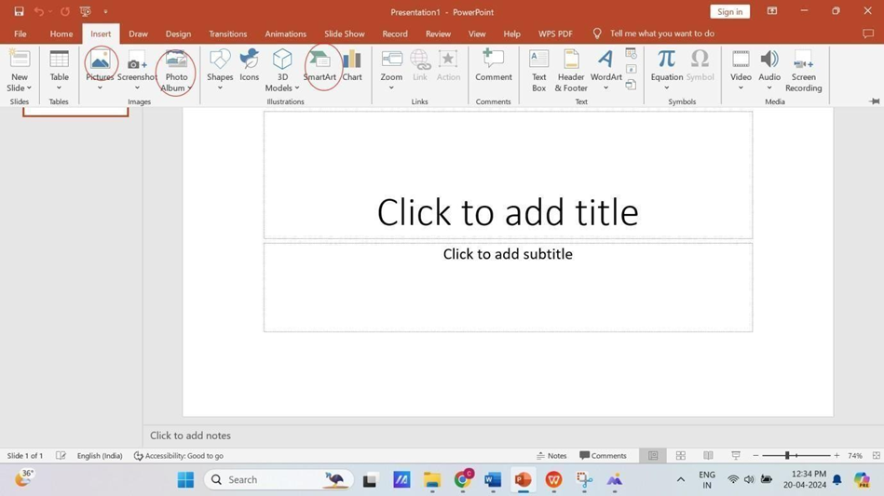

Slide 8
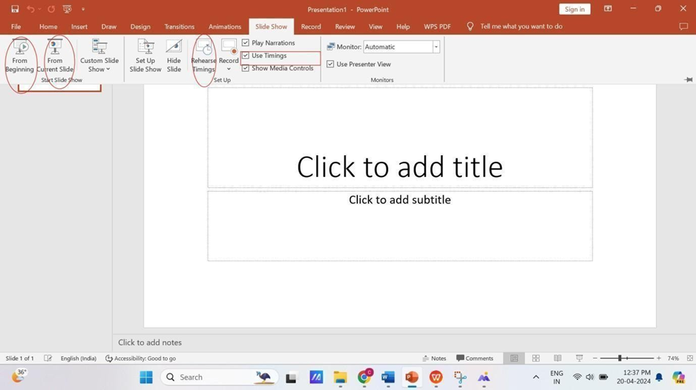

Slide 9
5. Structuring Your Presentation
- Organizing content: Outlining key points and structuring slides.
- Creating a narrative flow: Sequencing slides for clarity and coherence.
- Using sections: Grouping slides for organization and navigation.
6. Mastering Slide Show DeliveryRehearsing timings: Timing slide transitions and animations.
- Setting up slide show options: Configuring slideshow settings.
- Delivering presentations effectively: Tips for engaging the audience

Slide 10
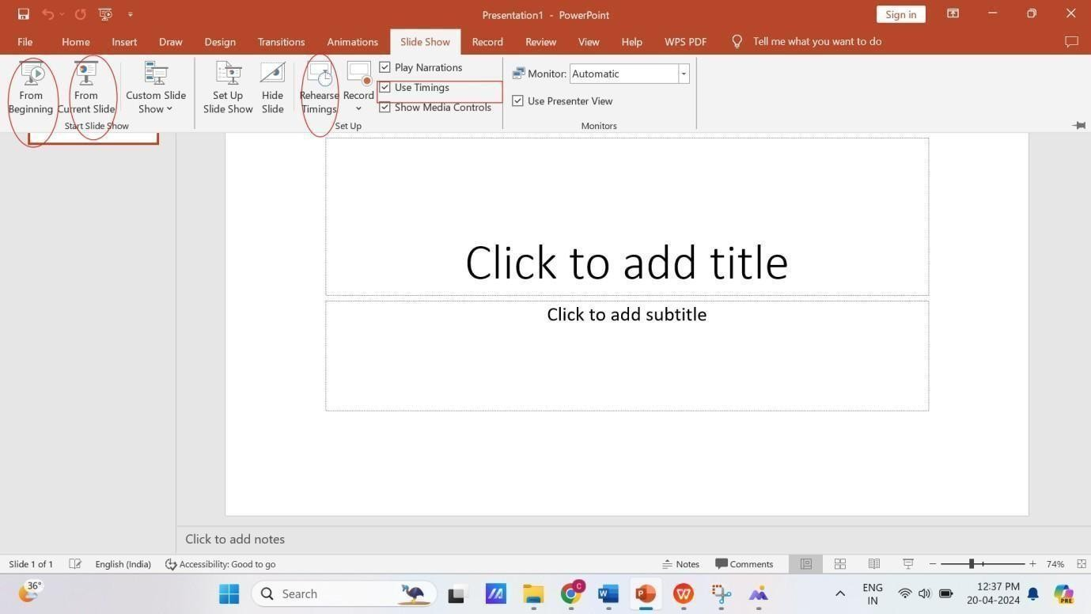

Slide 11
7. Collaboration and Sharing
- Sharing and collaborating on presentations: Using OneDrive or SharePoint.
- Version control: Tracking changes and managing revisions.
- Co-authoring presentations: Working simultaneously with team members

Slide 12
8. Tips for Accessibility and Inclusivity
- Designing for accessibility: Ensuring presentations are accessible to all.
- Using Alt text: Describing visuals for screen readers.
- Considering color contrast and readability: Making content easy to understand.
9. Advanced Features and Tips
- Creating custom animations: Fine-tuning animation effects.
- Using slide masters: Standardizing design elements across slides.
- Incorporating interactive elements: Hyperlinks, buttons, and triggers.

Slide 13
